Slide 1

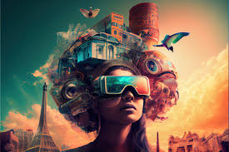
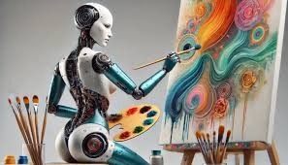
February 6
AI in Entertainment
Luisleonardo Ortiz

Slide 2
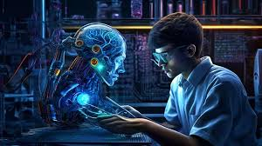
AI used in Entertainment
AI inside the entertainment industry are the use of generative Ai to make human like conversations or the ability to interact with humans for the purpose they were given. Examples of uses are from chatbots used to replicate a virtual friendship or connection to personal companions. Chatbots are not limited to just friendships or a portable wiki, they also are used to generate stories, images, and even used within certain games.
Building off generative AI in general it is used for numerous tasks that would take humans themselves a great amount of time to complete. This factor makes it very effective and makes a great experience for normal everyday users. Giving a quick and new experience to users rather then media/entertainment that goes off from a script.

Slide 3
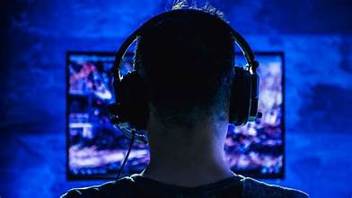
Video Games
Ai in video games is a revolutionary addition in this industry of entertainment. Even as early as the first games such ping pong AI has been used but over the years as AI evolves more and more it develops and builds the world of virtual games. From story building, to npcs and much more. AI is used as a multi-use case tool to greatly expand the world for video games. This can be simply done such as making the enemy be able to interact with the world, to giving characters in a game more personality and life. What makes AI so gripping on users in video games, is as it progresses it gives worlds a extra layer making them more realistic and unpredictable. In the past most games followed a linear script, most people especially if they played it before know what will happen. Now that is not the case multitude games using AI features makes the game replayable and unique so that users can continuously play content and not feel like its the same thing over and over again. Examples of this is Baldurs Gate 3, Dragon Dogma 2, Until dawn and much much more.

Slide 4

Advertising
In advertising AI is still a pretty new concept. Usually if AI was used at all it would be strictly for ideas, or maybe story boarding but now with the rise of generative AI, Advertising and Ai have had a recent twist in uses. The most popular example of this was the 2024 christmas Coke-a-cola advertisement where the entire content was made using AI. Many people have split thoughts on the use of AI in this industry. Some believe it to be lazy, unpeeling and lazy. While others see it as comedic, cost effective and cuts time. In current time of 2025, AI for videos has increasingly got better and better and will only see more uses.

Slide 5
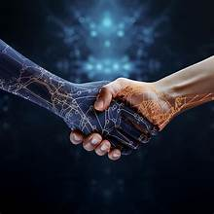
Chatbots
Chatbots are probably one of the most widespread and currently known uses for commercially used AI. They are used in numerous amount of technology but for the subject of this presentation we will be focusing on cases such as CHATGPT and other applications such as Character.ai. The reasons these two will be the main focus will be because for the everyday consumer most play with these applications to feed their curiosity or boredom. In these cases they are very well used especially as their individually used datasets grow and expand. As days pass their AI becomes more human, in terms of Character.AI consumers are looking to entertain themselves with a sort of virtual friend or roleplay. In these cases it has grown to be a very popular source of entertainment. Especially back during the times of Covid when human interaction was at its lowest. Ai was used to substitute loneliness as humans are initially social creatures.

Slide 6
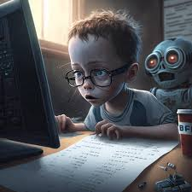
Flaws associated with this technology
While generative Ai and chatbots make for unique and live entertainment that does not mean it is without flaw. Issues associated with this technology spans from improper or incorrect generation, imperfections in grammar or imagery or a overall lower quality product compared to it being crafted by human. Various reasons for this can be from a broad or improper dataset that may not align with certain requests. The technology or application they use having a differing purpose or the technology is not advanced enough to make a perfect product to the request it received. At many points users may have to make lengthy inputs for even a chance of receiving their intended output.
Other issues associated with this technology is risk of generating Unreliable, Unsafe or NSFW outputs to the common user. This problem may affect children seeing how accessible this technology is, or expose users to unsafe information.

